Slide 1
Information Session Healthcare Support Worker Level 2

Slide 2
Who are Dynamic Training?
Established in 2007
Offices in Uxbridge and Hartlepool
Delivering:
Apprenticeships
Adult Education
Bespoke Training Solutions
Supporting circa 500 learners on a variety of programmes at any one time
Over 80 NHS Trust choose Dynamic Training with their ongoing Learning & Development Needs
Matrix Accredited
Skills for Health Quality Mark
A disability confident employer
Retained our Ofsted “good” inspection grade in Sept 2021
Part of Calder Holding BV
13 companies with 1000+ employees in the UK and the Netherlands.

Slide 3
What Is An Apprenticeship Standard?
An apprenticeship is a work-based learning programme
Developed by employers from industry
An apprenticeship consists of:
Knowledge of the areas involved in the staff's role at the appropriate level
Skills the learner is expected to demonstrate competently
Behaviours expected for the job role
Upskilling in maths and English and achievement of functional skills (if not exempt)
Achievement of a certificate, Diploma or other qualification / exams subject to the needs of the apprenticeship standard
Notes:
Apprenticeships are work-based training programmes
Industry Standards which have been developed by employers so for health this would be: NHS Trusts, General Practice, independent providers and hospices facilitated by Skills for Health and in partnership with Health Education England.

Slide 4
An apprenticeship is built upon an agreed partnership between

Slide 5
Accessible Apprenticeships
Accessible apprenticeships means providing apprenticeships to -individuals with special educational needs and disabilities – in adulthood referred as individuals with learning difficulties or disabilities and/or Autism.
Dynamic Training deliver accessible apprenticeship across our portfolio of programmes
Apprentices that are accessible may:
Be part time.
Require a job coach to support in the workplace.
Take longer to onboard.
Require adaptations to the working practices/environment

Slide 6
Reasonable adjustments to learning and assessment
Reasonable adjustments can be made for example:
Extra time allowance
Reader / scriber
Assistive technology
Alternative assessment methods
British sign language interpreter
Timed rest breaks
121 support
Increased support.

Slide 7
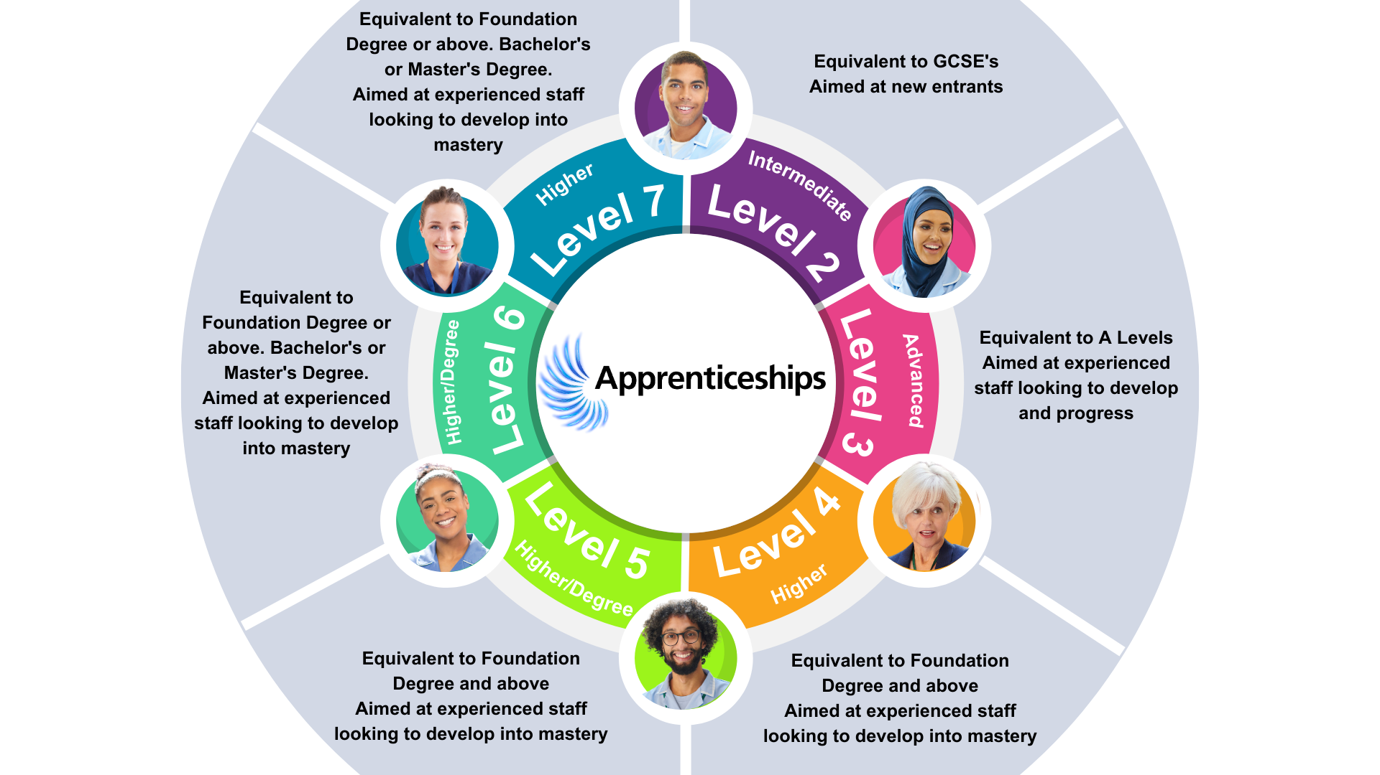
What are Apprenticeship Standards?
Notes:
Level 2 is suitable for staff who are new to or transferring from other roles into the department or workplace.
Level 3 may be staff who are new or often existing staff who wish to consolidate their practice to progress to a higher role or e.g. in Healthcare into nursing or Higher Education.
Level 4-5 are more advanced and would be for staff transitioning to higher banding or Degree level.
Level 6 and 7 are Apprenticeship Degree and Apprenticeship Masters Degree
Apprenticeships timeframes can vary;
Typically, a Level 2 apprenticeship takes 12 months plus EPA to complete
Typically, a Level 3 apprenticeship takes 18 months plus EPA to complete
Understanding how academic qualifications relate to apprenticeships;

Slide 8
Functional Skills & Developing English & Maths
Functional skills in maths and English is a mandatory component of all apprenticeship programmes
Learners cannot achieve their apprenticeship without achievement of Functional Skills
You are exempt from completing Functional Skills if you have GCSE A*-C/9-4 or equivalent and proof of this
If you are required to complete Functional Skills, you are expected to achieve these within the first six to nine months of provision
Learners who are working at more than one level below the required level of Functional Skills will not be able to progress onto the programme
Development of maths and English is a core component of the programme irrespective of exemptions for those that need / want upskilling
Notes:
Explain NARIC, equivalents
Support with FS is available to all – give memory burn example - not just about achievement. Even if exempt.
You have until your first planning meeting to produce FS exemptions certs otherwise you will need to achieve your Functional Skills.

Slide 9
Department of Education Pilot
Providers including Dynamic Training have been selected to pilot onboarding learners who do not have an EHCP but do have learning disabilities/difficulties and/or Autism to undertake an apprenticeship and access the flexibility of Entry 3 functional skills in math’s and/or English rather than the traditional level 1 and/or level 2 functional skills requirement.
Notes:
This pilot only runs until May 2024, so learners will need to be onboarded before then.

Slide 10
Healthcare Support Worker Level 2
This apprenticeship is perfect for:
^{Healthcare Support Workers}
^{The apprentices will achieve:}
Healthcare Support Worker Apprenticeship Standard Level 2 Certificate
Level 1 or 2 Functional Skills in maths and English (if applicable)

Slide 11
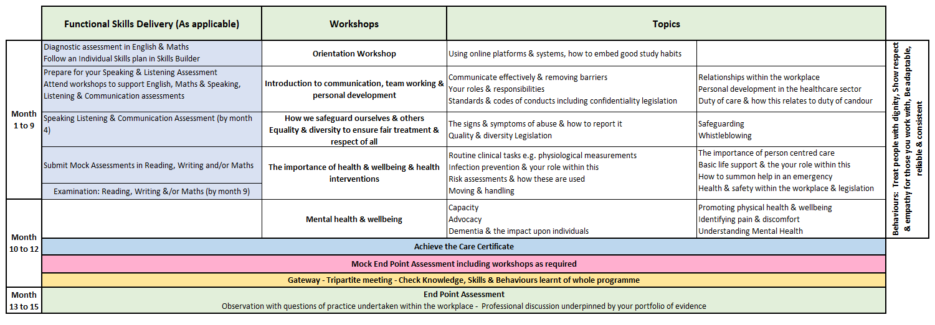
Health Care Support Worker Level 2

Slide 12
End Point Assessment
End Point Assessment (EPA) happens at the end of the programme
Apprentices need to pass this to achieve their apprenticeship
EPA involves independent assessment at the end of the programme which includes:
Observation in the Workplace
Professional discussion underpinned by the learner portfolio
From this apprentices can achieve: Fail, Pass, & Distinction
Notes:
Explain end of the program – achievement of standard, and Functional skills
All off the job has been completed
Knowledge Test: The apprentice undertakes a multi-choice test to last a maximum of 60 minutes and include 50 equally weighted multi-choice questions The test is to be completed online and is subject to invigilation
Portfolio-based Interview: The interview is for 30-45 minutes and scored out of 100. The interview assesses understanding and learning shown in the Portfolio; the Portfolio is not directly assessed.
Project Presentation: The apprentice delivers a presentation to the EPAO on a project they have completed or a process they have improved. The presentation lasts 10-15 minutes, with a further 10-15 minutes for a Q&A session. The presentation is out of 100. The presentation is expected to be produced using Microsoft Office PowerPoint or Prezi, demonstrating a minimum level of IT skills.
Each part of the EPA has a pass mark of 60% and must be passed in order to pass the overall apprentice

Slide 13
The Apprentice Journey
Notes:
Pre programme start
Information Advice and Guidance– informed decision – right learner, right time, right programme.
Application to check eligibility and identify prior experience and learning must be completed
Skillscan to identify prior learning and experience against the standard
Potential apprentices complete the Skills Builder online assessments prior to confirmation to ensure learner is at right level of English and maths. Signposting to support to upskill offered.
Cognassist neurodiversity assessment: helps learners identify their learning style and supports with strategies which are built into their portfolio with the support of their skills coaches.
Meeting with manager, coach and apprentice to confirm and agree learning plan.
Programme Start
Induction - official start to programme
Online workshops once/twice a month for duration of programme
via Zoom, fully interactive.
Coach support – remotely via an eportfolio monthly booked session plus ongoing communication
Assessment in the workplace - observations or witness statements every 12 weeks
Review every 12 weeks (manager/mentor, learner, skills and development coach)
Additional Functional & Digital Skills embedded into our taught sessions as well as providing additional support through Skills Builder and online sessions

Slide 14
E-learning Tools and Portals
The tools learners use to support achievement of their apprenticeship programme

Slide 15
Dedicated Learning Time
Activity | Average Duration
Teaching and Learning Reviews | 2 hours– in person or online The Apprentice will meet their Coach every 4-6 weeks Line manager/workplace mentor is expected to be present to support the Apprentice as part of this.
10 to 12-Week Progress Reviews | 90 mins every 10 to 12 weeks This is a three-way discussion involving the Coach, Line Manager/Workplace Mentor, and Apprentice - share understanding of progress against the full apprenticeship
Online Workshops via MS Teams / Zoom | Approximately once per month, subject to programme Full day workshops to teach the knowledge and skills against the required standard Workshop dates are planned in advance for whole programme.
Independent learning / time for study: In work learning | Minimum half a day per week required 1-2 hours per week
Notes:
Independent learning / time for study – reading, watching developmental videos, research tasks and projects
In work learning – Shadowing, stepping up, coaching, mentoring

Slide 16
Off the Job Learning
To be eligible:
At least 20% of the apprentice’s normal working hours must be spent on off-the-job training
For apprentices working 30 hours or more per week this is an average of 6 hours of off-the-job training per week over the planned duration
Apprentices will need to complete evidence of ‘off the job’ by logging this on their OneFile e-portfolio
Off the job learning is reviewed with Learner, Line Manger and Tutor at every progress visit.
Notes:
To be eligible for government funding at least 20% of the apprentice’s normal working hours, capped at 30 hours per week over the planned duration of the apprenticeship practical period, must be spent on off-the-job training
This means that the minimum requirement, for apprentices working 30 hours or more per week is an average of 6 hours of off-the-job training per week (i.e., 20% of 30 hours) over the planned duration
Apprentices will need to complete evidence of ‘off the job’ by logging this on their OneFile e-portfolio
Off the job learning is reviewed with Learner, Line Manger and Tutor at every progress visit

Slide 17
Off the job – what counts?
Off the job is anything in the workplace that is new learning and moves an apprentice towards the successful completion of an apprenticeship standard.
Visiting other departments
Conferences
Mentoring
Inhouse training
Reflective journal
Coaching sessions
Roleplay
Written assignments
Research
Departmental
rotation
Team training
Classroom or taught sessions
Simulation
exercises
E-portfolio
One to ones
Shadowing colleagues
Independent research
Workshops

Slide 18
What’s everyone’s responsibilities?
The Apprentice
Line Manager / Mentor
Dynamic Training
Complete work meeting the targets set
Attend any training sessions made available to them
Communicate clearly and regularly with their Tutor
Commence Functional Skills from the beginning of their programme
Complete off-the-Job activity every month
Support development of the learner, giving opportunity to practice new skills attained in the workplace
Allow the learner to attend all agreed Tutor sessions
Support with off-the-job learning identification and time
Support the apprentice to undertake all tasks
Attend progress reviews
Create an individual learning plan
Identify any recognition of prior learning
Provide quality training, support and assessment
Provide regular feedback and development opportunities
Adapt delivery and assessment to meet individual needs were applicable
Notes:
Support the apprentice to undertake all tasks e.g. through work shadowing other departments

Slide 19
Questions For Reflection?
How would this benefit me?
Would I be able to commit?
What other commitments do I currently have?
Would my department support this?
What would I need from my employer to support me?

Slide 20
Mentoring an Apprentice Workshops
Aimed at the learner’s line manager or mentor
Workshops are delivered monthly online – two hours
By the end of the session, you will be able to:
Describe the structure of an apprenticeship programme
Explain the principles that underpin the mentoring process
Initiate and establish a mentoring process with an apprentice

Slide 21
Any questions ?
hello@dynamictraining.org.uk
Thank you.

