Slide 1
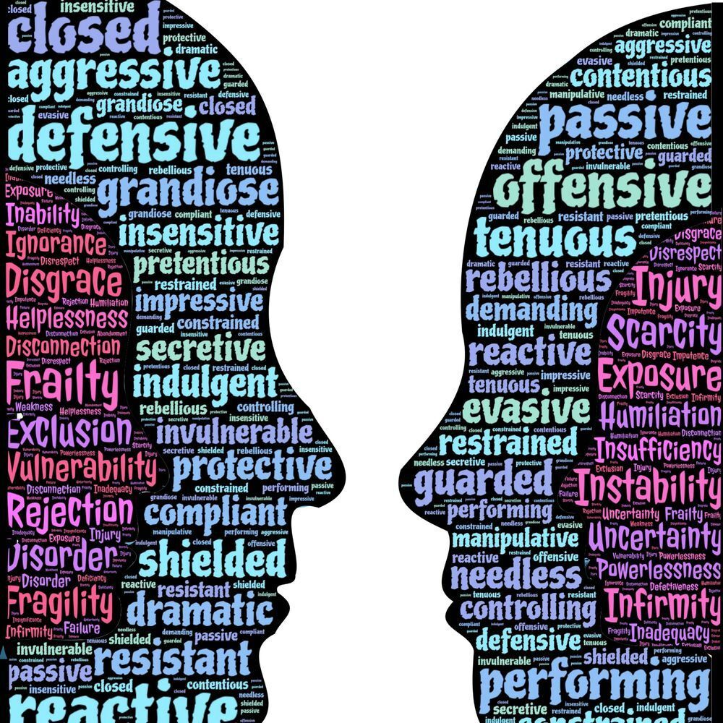
Difficult Conversations Workshop

Slide 2
Understanding Difficult Conversations
What constitutes as a difficult conversation?
What type of scenarios may we find ourselves in that may lead to difficult conversations?
Why is it important to have these conversations in a timely manner?
How to use difficult conversations constructively.

Slide 3
What constitutes as a difficult conversation?
In the chat function type in what you think the definition of a difficult conversation is.
Notes:
A difficult conversation is one whose primary subject matter is potentially contentious and / or sensitive and may elicit strong, complex emotions that can be hard to predict or control.

Slide 4
What type of scenarios may we find ourselves in that may lead to difficult conversations?
Turning down an employee’s idea
Encouraging an employee to improve their performance
Resolving conflict between team members
Terminating a position
Asking for a raise or promotion
Reporting bad behaviour, like abuse, sexual harassment, discrimination, LGBTQ+ discrimination
Giving negative feedback
Discussing personal problems
Asking managers for study time to complete apprenticeship work
And many more day-to-day situations we come across!

Slide 5
Notes:
Importance of having difficult conversations
Having difficult conversations can be challenging, but they're essential. Here are some reasons:Better collaboration. You can learn how your colleagues feel about a specific topic or issue to better collaborate with them in the future.
It improves public speaking skills. They help you become more comfortable speaking up in meetings and other professional situations.
Better decision-making. It can help you make better decisions in the future based on your understanding of what happened in the past.
It develops conflict resolution skills. Having difficult conversations can help you learn how to respond when other colleagues hold such conversations with you, which can ultimately lead to better outcomes when handling conflict situations.
Aids communication. It helps keep the lines of communication open and honest, which is essential in working relationships.
It develops essential skills. Having difficult conversations can help you develop skills to become a better communicator and improve your relationship with other employees.
Aids growth. It helps you grow as an individual by enabling you to reflect on and improve on some of your actions.

Slide 6
Speaking from experience
The friend / colleague situation
The talking with a relative about Garlic and palliative care
The conversation about unexpected death
The manager conversation

Slide 7
Now we know the types of difficult conversations we may encounter; how can we equip ourselves?
Understand what it means
Prepare yourself
Contact the parties and set a time
Assess the situation
Assume positive intent
Listen actively
Express your feelings and ideas
Practice self-awareness
Be mindful of your body language and tone
Notes:
1. Understand what it means
The first step towards a successful, difficult conversation is understanding what it means. A difficult conversation differs from an argument. An argument involves two individuals who disagree on one point, while each tries to convince the other to agree with their point of view. Difficult conversations focus more on listening than arguing. It's about understanding each person's wants before proceeding with any action plan or solution. Recognise when a conversation with a colleague is going to be difficult. This effort can be a challenge, as many individuals avoid these conversations. But, recognizing when a conversation is likely to be difficult may make it easier for you to prepare yourself for what's coming next.
2. Prepare yourself
Plan how you want to approach the conversation and prepare yourself mentally for what might happen during the process. This stage can mean thinking about what to say or writing it down. It can also mean getting additional information or documentation relevant to the conversation. You may keep things organized and focus on these points rather than on other issues that may arise during the discussion. If possible, take some time before the conversation to relax and ensure you're feeling calm and ready.
3. Contact the parties and set a time
Set aside some time in which you can implement the conversation with the other party. You may set this meeting during the weekend, so it doesn't interfere with either of your schedules. It may also be preferable to meet outside work, as keeping your composure at work could be challenging. If this isn't possible, you may find a quiet corner with no distractions and where you can focus completely on what you want to discuss with your colleague. You can also consider scheduling multiple meetings over several days or weeks until both parties resolve the issue.
4. Assess the situation
Before starting a difficult conversation, ensure you know what it's about. If you don't understand why your colleague is upset and angry, you may be unable to talk about it effectively. For example, if they're angry because of an issue in their personal life, ensure you both have time to discuss this before discussing their work performance or behaviour. Otherwise, they may feel you're judging them unfairly. This step is crucial because it helps you make an informed decision about how to proceed.
5. Assume positive intent
When speaking with an upset colleague, it can be tempting to assume an ulterior motive or that they're being manipulative. Instead, try to assume they're having difficulty communicating their feelings. This action means you understand that the other individual holds no malicious intent.
6. Listen actively
Listen closely to what the other employee says for a productive dialogue. When you do this, you hear what individuals say, not just the words they use but also their underlying emotions and intentions. This action enables you to respond appropriately because you understand the other party's perspective and empathize with them. Avoid assuming that your opinion is the only one that matters. Asking questions and listening are great ways to show that you're interested in what the other party is saying. Give them time and space to respond before moving on to another topic or sharing your thoughts and feelings about the conversation.
7. Express your feelings and ideas
Be honest about how you feel, even if it seems uncomfortable. If you hold back your true feelings during a difficult conversation, they may come out later and do more damage. Try to develop solutions together rather than making an announcement and hoping that the other party agrees with it. Instead, think about what would work best for all parties and find solutions.
8. Practice self-awareness
Listen to the other party's opinion, even if you disagree. This step is essential if the subject of your discussion is sensitive. If you get upset during the conversation, take a few deep breaths and try again. Be ready to apologize if you made a mistake. Ensure that your colleague understands what requires discussion and why it's essential. You may also want to be aware of your feelings and those of others involved in the discussion. Try not to focus on what they did wrong or your emotions. Instead, focus on your own goals for the discussion. Ensure you're not overreacting or taking things too personally. This action may help ensure your message is clear and compelling without causing undue damage.
9. Be mindful of your body language and tone
Be mindful of your body language and tone of voice as you talk. Ensure you're making eye contact with the other person, as this shows them you're listening. Also, avoid using harsh language or yelling at them as this may only worsen things. When explaining your concerns, try using 'I' statements, such as 'I feel' rather than 'You did'. This action makes it easier for others to empathise with your opinion without getting defensive. You may also want to avoid offensive or sensitive topics, as these are not appropriate or acceptable in most workplaces.

Slide 9
Tips for making a difficult conversation productive
The following are tips that can help make a difficult conversation effective and productive:
Find a neutral location for the conversation. This can be a good place to start the conversation because it can help the employee feel less nervous.
Ensure all parties know what to expect. If all parties know what to expect from the conversation, it may help them prepare mentally for the discussion and stay calm and focused on the subject.
Prepare yourself for any emotions that might arise during the conversation. This action can help you stay calm, making it easier for others around you to listen and respond well.
Consider bringing a neutral party into the conversation. This individual can be your supervisor and manager. They can help facilitate the conversation to benefit everyone involved.
Practice mindfulness. This effort can help you focus on the difficult conversation and manage emotional reactions that may distract or derail you from getting the desired result.
Resolve issues. Try to reach a resolution that both parties can agree on and compromise if necessary.

Slide 11
Useful sites:
Indeed
You tube : Mel Robbins & TED
ACAS
Open university
NSPCC

