Slide 1
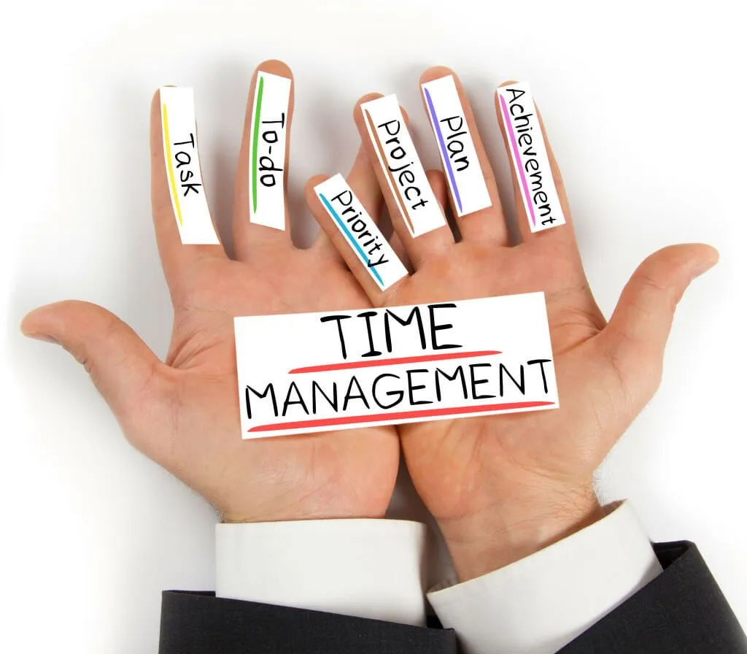
Time Management
Workshop
Notes:
In this short workshop, we will delve into effective time management strategies tailored to individuals balancing a full-time job, household responsibilities, social engagements, and pursuing an apprenticeship. You will learn practical tips, techniques, and tools to optimize your time and achieve harmony among your various commitments.

Slide 2
What is time management?
Notes:
Definition of Time Management Time management is the process of planning, organizing, and controlling the time spent on specific activities, especially to increase effectiveness, efficiency, and productivity. It involves techniques and strategies for allocating time effectively to achieve desired goals and objectives.

Slide 3
Why is time management important?
Notes:
Importance of Time Management Effective time management allows individuals to accomplish more in less time, reduce stress, and improve work-life balance. It involves setting priorities, creating schedules, and minimizing distractions to maximize the use of available time.

Slide 4
Notes:
What are some common time management techniques or strategies that individuals can use to improve their productivity?
There are several time management techniques and strategies that individuals can use to improve their productivity. Here are some common ones:
Prioritization: Identifying and focusing on the most important tasks first can help individuals make the best use of their time.
Goal Setting: Setting clear and achievable goals provides direction and motivation, helping individuals stay focused on what's important.
Planning and Scheduling: Creating a daily or weekly schedule can help individuals allocate time for specific tasks and avoid procrastination.
Task Breakdown: Breaking down larger tasks into smaller, manageable steps can make them less overwhelming and easier to tackle.
Time Blocking: Allocating specific blocks of time for different types of tasks can help individuals maintain focus and avoid multitasking.
Eliminating Time Wasters: Identifying and minimizing activities that consume time without adding value can free up more time for important tasks.
Setting Boundaries: Establishing boundaries around work hours, email checking, and other activities can help individuals maintain a healthy work-life balance.
Delegation: Offloading tasks to others when possible, can free up time for more high-priority activities.
Avoiding Overcommitment: Learning to say no and managing commitments to avoid overloading one's schedule.
Regular Breaks: Taking regular breaks can help maintain focus and prevent burnout.
By incorporating these techniques into their daily routines, individuals can enhance their time management skills and improve their overall productivity.

Slide 5
Time Management & Studying

Slide 6
Notes:
Introduce techniques such as Eisenhower Matrix, ABC prioritization, and Pareto Principle.
Discuss how to identify and prioritize tasks based on urgency and importance.
Encourage participants to apply prioritization techniques to their daily routines.

Slide 7
Procrastination

Slide 8
Time Blocking & Scheduling:
Create a weekly schedule, allocate time for work, time for study, household chores, social activities and personal time.
Must be flexible and adaptable.
Effective Communication & Delegation:
Use to manage expectations at work and home.
Delegate tasks to lighten your workload.
Use technology and tools:
Productivity apps, task managers, calendars, time tracking apps.
Remember however no AI for completion of assignments:
We will know!
This Photo by Unknown Author is licensed under CC BY-SA-NC

Slide 9
Time Management Plans
Eisenhower Matrix
https://www.eisenhower.me/eisenhower-matrix/
ABC Prioritisation
https://www.timedoctor.com/blog/abc-method-time-management/
Pareto Principle
https://en.wikipedia.org/wiki/Pareto_principle
Time Management Apps
Todoist
Rescue Time
Forest
Toggl Track
Focus Booster
This Photo by Unknown Author is licensed under CC BY-SA
Notes:
Definition of Time Management Time management is the process of planning, organizing, and controlling the time spent on specific activities, especially to increase effectiveness, efficiency, and productivity. It involves techniques and strategies for allocating time effectively to achieve desired goals and objectives.

