Slide 1
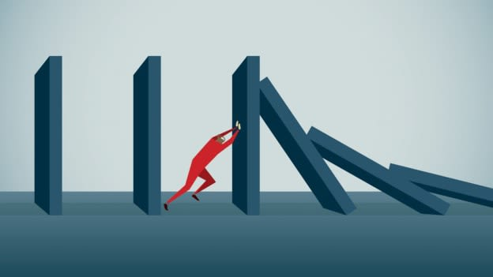
Resilience
Workshop

Slide 2
Resilience is defined as “ the ability to cope under pressure. A person who copes well under pressure is resilient. Research suggests that the ability to cope well under pressure is based on a positive outlook, combined with strategies to manage pressure”.
To be resilient in your NHS / Work Role is to feel able to approach the potential challenges that your role as a support worker may bring, without these impacting on your life outside of work and on your mental and physical wellbeing. It is important that you feel happy and confident within your role.

Slide 4
In the chat box type in what you would consider to be a risk factor for resilience.

Slide 5
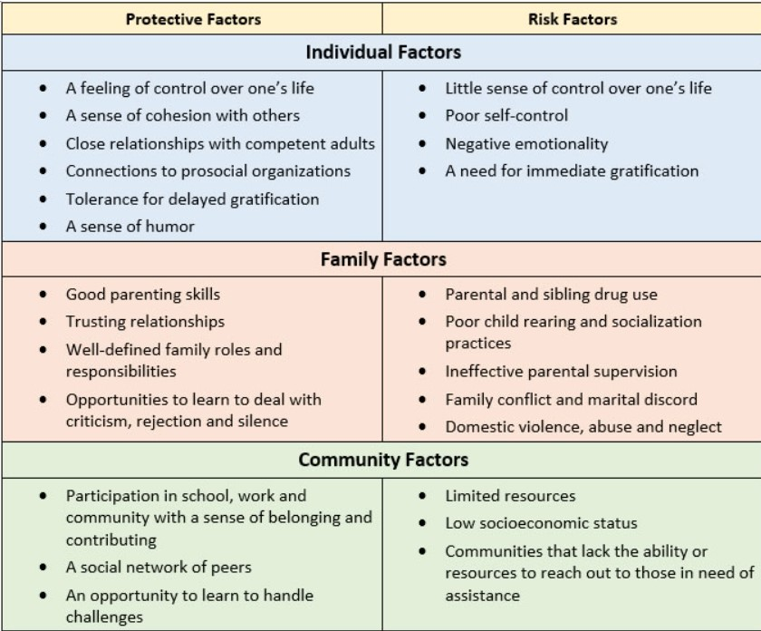

Slide 6
Notes:
The terms 'resilience' and 'managing stress' can mean different things to different people. We might understand them differently because our experiences shape how we feel stress, and how easily we can respond to it.
Some people may think that our response to stress is something that we can all easily control. But this is not true. There are some causes of stress that are beyond our control. And some ways of managing stress and building resilience are not always available to us.
This makes dealing with stress very personal – it may be harder for some of us than for others. Some experiences that can make it more difficult include:
Having a long-term physical health condition
Having a mental health problem
Experiencing discrimination and hate, including racism, homophobia, biphobia or transphobia
Living far away from family or friends, or having difficult relationships with them
Experiencing loneliness
Experiencing poverty and money worries, including debt or problems with benefits
Living in an area with poor access to services like healthcare, public transport and green spaces
Being a single parent
Being a carer
Having poor quality housing
Lacking safety and protection, such as living in areas with poor policing
Research shows that it is easier to develop resilience if we don't face these barriers. But many of these things are difficult or impossible to change.
Remember: if you face these barriers, this is not your fault. And it is not up to you to remove these barriers yourself.

Slide 7
Resilience
Building

Slide 8
Coping Strategies
Deep breathing
Meditation
Exercise
Journaling
Talking with a friend
Positive thoughts
Taking a bath
Reading a book
Aromatherapy
How to improve your coping skills
Identify your stressors: identify what is causing you to feel stressed, this can aid with developing positive coping mechanisms
Current coping skills: how are you currently coping with the stressors are you using negative or positive coping mechanisms.
Something new: try a different coping mechanism until you find one that works best for you
Get into a habit: make your coping skills part of your daily routine, try taking a few minutes in your day to carry out some deep breathing exercises or try 5 minutes of meditation, try with friends and colleagues if you can.
Reach out for help: if you cannot find a coping mechanism that works for you be sure to reach out for help you are not alone.

Slide 9
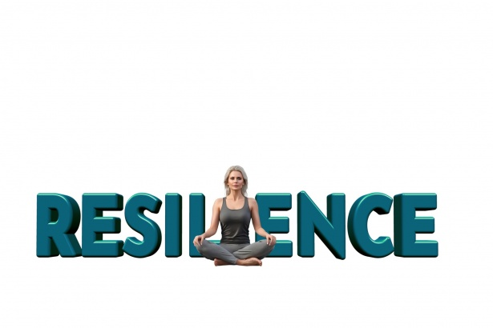

Slide 10
Useful Websites
https://www.mind.org.uk/need-urgent-help/what-can-i-do-to-help-myself-cope/
https://www.samaritans.org/how-we-can-help/schools/deal/deal-resources/coping-strategies/
https://www.skillsforcare.org.uk/Support-for-leaders-and-managers/Managing-people/Wellbeing/Building-resilience.aspx
Useful Apps
Headspace
Insight Timer
Meditation Oasis
Smiling Mind
Calm
Self-help for anxiety management

