Slide 1
Apprenticeship Deep Dive: Health Care Science Assistant Level 2 Health Care Science Associate Level 4

Slide 2
Who are Dynamic Training?
Established in 2007
Offices in Uxbridge and Hartlepool
Delivering:
Apprenticeships
Adult Education
Bespoke Training Solutions
Supporting circa 500 learners on a variety of programmes at any one time
Over 80 NHS Trust choose Dynamic Training with their ongoing Learning & Development Needs
Matrix Accredited
Skills for Health Quality Mark
A disability confident employer
Retained our Ofsted “good” inspection grade in Sept 2021
Part of Calder Holding BV
13 companies with 1000+ employees in the UK and the Netherlands.

Slide 3
Healthcare Science Apprenticeships
^{Health Care Science Assistant}
^{The apprentices will achieve:}
Health Care Science Assistant Level 2 Certificate
Level 2 Diploma in Healthcare Science
Level 1 Functional Skills in maths and English (if applicable)
^{Health Care Science Associate}
^{The apprentices will achieve:}
Health Care Science Associate Level 4 Certificate
Level 4 Diploma in Healthcare Science
Level 2 Functional Skills in maths and English (if applicable)

Slide 4
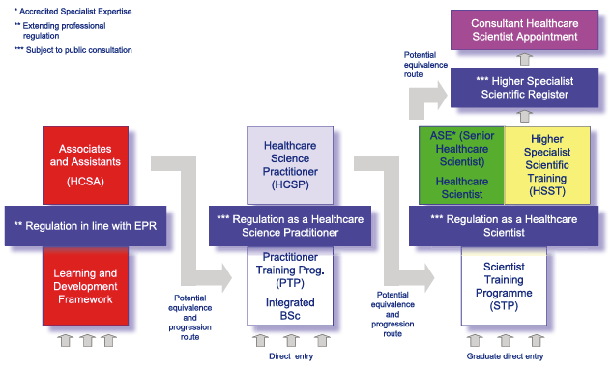
Modernising Scientific Careers
Notes:
The modernizing scientistic careers has introduced a clear career and training pathway and provided details regarding the roles themselves.

Slide 5
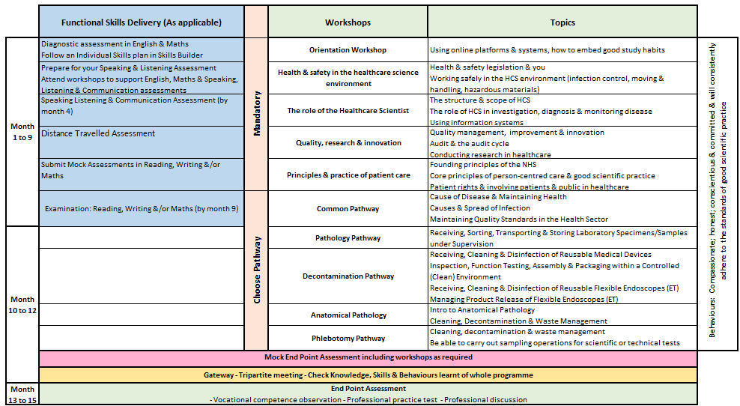
Healthcare Science Assistant - Level 2

Slide 6
Healthcare Science Assistant - Level 2
^{Mandatory Units}
^{Unit 1: Healthcare Science}
Unit 2: Employee Rights, Responsibilities and Personal Development in Healthcare Science
Unit 3: Working in Partnership in Healthcare Science
Unit4: Investigating, Treating and Managing Human Disease and Disorder
Unit 5: Working Safely in the Healthcare Science Environment
^{Optional Units}
Over 100 optional units to select from, these fall into either general or a specific specialism.
Some specialisms we currently deliver include;
^{Life Sciences}
^{Decontamination}
^{Cardiac/Respiratory/Sleep}
Equipment Management and clinical Engineering
^{Ophthalmology}
^{Phlebotomy}
Notes:
Ali from eastwood park
Science L2
Core/Mandatory Units
Part 1: Study Skills & Using Our Systems
Part 2: Health & Safety in the HCS Environment
Part 3: The Role of the Healthcare Scientist
Part 4: Quality, Research & Innovation
Part 5: Principles and Practice of Care

Slide 7
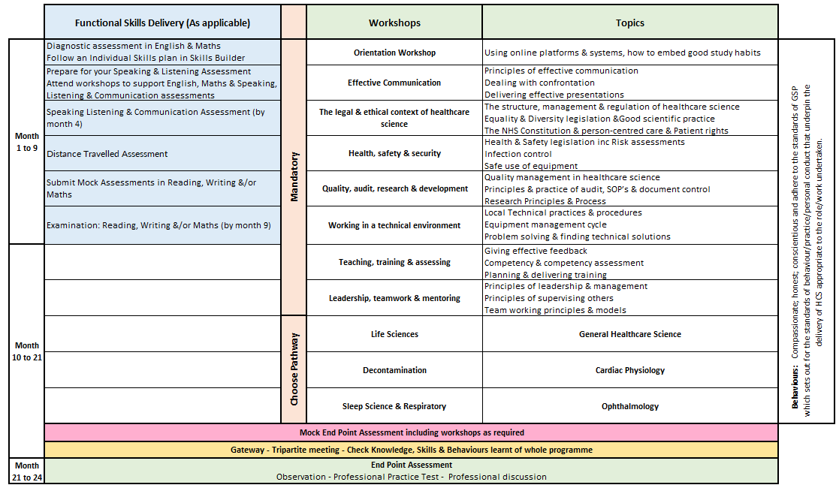
Healthcare Science Associate - Level 4

Slide 8
Healthcare Science Associate - Level 4
^{Mandatory Units}
Unit 1: Skills for Lifelong Learning
Unit 2: Professional Practice and Person-centred Care
Unit 3: Legal and Ethical Context of Practice
Unit 4: Health, Safety and Security in the Health Care Science Environment
Unit 5: Technical Scientific Services
Unit 6: Effective Communication in Healthcare
Unit 7: Audit, Research, Development and Innovation
Unit 8: Leadership and Teamwork
Unit 9: Teaching, Learning and Assessing Practical Skills
Unit 10: Continuing Personal and Professional Development
^{Optional Units}
Over 100 optional units to select from, these fall into either general or a specific specialism.
Some specialisms we currently deliver include;
^{Life Sciences - Pathology}
^{Cardiac}
^{Respiratory/Sleep}
^{Decontamination}
^{Ophthalmology}
^{Generic healthcare science}
Notes:
Moorfield's – optahmology
Science L4
Core/Mandatory Units
Part 1: Becoming A Successful Student & Scientist
Part 2: Effective Communication
Part 3: The Legal & Ethical Context of Healthcare Science
Part 4: Health, Safety & Security
Part 5: Quality, Audit, Research & Innovation
Part 6: Working in a Technical Environment
Part 7: Teaching, Training & Assessing
Part 8: Leadership, Supervision, Mentoring & Teamwork
Generic healthcare science pathway – all knowledge – A&P / maths stats and physics/epidemiology - Unit 11/17/14/15

Slide 9
Course Content Level 2
Unit 24: Anatomy and Physiology: Cardiovascular, Lymphatic and Respiratory Systems
Unit 79: Performing Spirometry and Bronchodilator Response in Adults
Unit 80: Performing Spot Oxygen Measurements
Unit 81: Performing Spirometry in Children
Unit 82: Interpreting and Reporting Spirometry Results
^{Unit 116: Sleep Diagnostics}
Notes:
Ali from eastwood park

Slide 10
Course Content Level 4
Unit 50: Scientific Basis of Cardiovascular, Respiratory and Sleep Science: Anatomy, Histology and Physiology of the Respiratory System
Unit 51: Scientific Basis of Cardiovascular, Respiratory and Sleep Science: Scientific Basis of Respiratory Disorders of Sleep
Unit 59: Spirometry and Bronchodilator Response in Adults
Unit 60: Measurement of Single Breath Gas Transfer
Unit 136: Measurement of Static Lung Volumes in Adults
^{Unit 61: Sleep Diagnostics}
Unit 133: Measuring Peripheral Oxygen Saturation
^{Unit 135: Sleep Therapy}
Notes:
Ali from eastwood park

Slide 11
Individual Training Plan
A bespoke training plan will be designed around the chosen units.
The training plan will include all tutorials, coaching sessions and formal progress review.
Any specific additional support needs will be discussed and agreed with the learner.
If the learner is required to undertake functional skills, then this will be integrated within the training plan.
Learners prior learning will be reviewed and this will taken into consideration when building the training plan.
Notes:
Ali from eastwood park
Science L2
Core/Mandatory Units
Part 1: Study Skills & Using Our Systems
Part 2: Health & Safety in the HCS Environment
Part 3: The Role of the Healthcare Scientist
Part 4: Quality, Research & Innovation
Part 5: Principles and Practice of Care

Slide 12
Dedicated Learning Time
Activity | Average Duration
Online Workshops via MS Teams / Zoom | Approximately once per month, subject to programme Full day workshops to teach the knowledge and skills against the required standard Workshop dates are planned for whole programme.
10 to 12-Week Progress Reviews | 90 mins for first meeting 30-60mins every 10 to 12 weeks thereafter This is a three-way discussion involving the Coach, Line Manager/Workplace Mentor, and Apprentice - share understanding of progress against the full apprenticeship
121 / Review /ALS | Tutor and learner will meet every 4-6 weeks to provide additional learning support and review their progress. Dependent on learners needs.
Independent learning / time for study In work learning | Minimum half a day per week required as protected study time – written into the off duty. 1-2 hours per week
Notes:
Independent learning / time for study – reading, watching developmental videos, research tasks and projects
In work learning – Shadowing, stepping up, coaching, mentoring

Slide 13
Learner Journal
Employers will have access to view learners OneFile.
Learner Journal reflections are a good way of seeing what is happening at floor level and identifying any changes that need to be implemented.
These reflections can often form the basis for team learning days and CPD.
We are offering a monthly repeated training session for Line managers, mentors or apprenticeship / Educators on how to get the most out of OneFile.

Slide 14
Methods of Assessment
After each teaching session a learning assessment record (LAR) will be released on OneFile with learner instructions and resources.
Coaching will be given to learners that require support.
Assessment methods include:
Workbooks
Witness Testimony's
Competency Based Assessments
Professional Discussion
Observations in the workplace both online and face to face

Slide 15
End Point Assessment
Undertaken by the nation School of Healthcare Science (NSHCS)
End Point Assessment (EPA) happens at the end of the programme
Apprentices need to pass this to achieve their apprenticeship
EPA involves independent assessment at the end of the programme which includes:
Vocational Competence Observation (VCO)
Professional Practice Test (PPT)
Professional Discussion (PD)
From this apprentices can achieve: Fail, Pass or Distinction
Notes:
Als discuss mock assessment methodology and activity

Slide 16
The Apprentice Journey
Notes:
Pre programme start
Information Advice and Guidance– informed decision – right learner, right time, right programme.
Application to check eligibility and identify prior experience and learning must be completed
Skillscan to identify prior learning and experience against the standard
Potential apprentices complete the Skills Builder online assessments prior to confirmation to ensure learner is at right level of English and maths. Signposting to support to upskill offered.
Cognassist neurodiversity assessment: helps learners identify their learning style and supports with strategies which are built into their portfolio with the support of their skills coaches.
Meeting with manager, coach and apprentice to confirm and agree learning plan.
Programme Start
Induction - official start to programme
Online workshops once/twice a month for duration of programme
via Zoom, fully interactive.
Coach support – remotely via an eportfolio monthly booked session plus ongoing communication
Assessment in the workplace - observations or witness statements every 12 weeks
Review every 12 weeks (manager/mentor, learner, skills and development coach)
Additional Functional & Digital Skills embedded into our taught sessions as well as providing additional support through Skills Builder and online sessions

Slide 17
E-learning Tools and Portals
The tools learners use to support achievement of their apprenticeship programme

Slide 18
What’s everyone’s responsibilities?
The Apprentice
Line Manager / Mentor
Dynamic Training
Complete work meeting the targets set
Attend any training sessions made available to them
Communicate clearly and regularly with their Skills and Development Coach
Commence Functional Skills from the beginning of their programme
Complete off-the-Job activity every month
Support development of the learner, giving opportunity to practice new skills attained in the workplace
Allow the learner to attend all agreed Tutor sessions
Support with off-the-job learning identification and time
Support the apprentice to undertake all tasks
Attend progress reviews
Create an individual learning plan
Identify any recognition of prior learning
Provide quality training, support and assessment
Provide regular feedback and development opportunities
Adapt delivery and assessment to meet individual needs were applicable
Notes:
Support the apprentice to undertake all tasks e.g. through work shadowing other departments

Slide 19
Mentoring an Apprentice Workshops
Aimed at the learner’s line manager or mentor
Workshops are delivered monthly online – two hours
By the end of the session, you will be able to:
Describe the structure of an apprenticeship programme
Explain the principles that underpin the mentoring process
Initiate and establish a mentoring process with an apprentice

Slide 20
Any questions ?
hello@dynamictraining.org.uk
Thank you.

