Slide 1
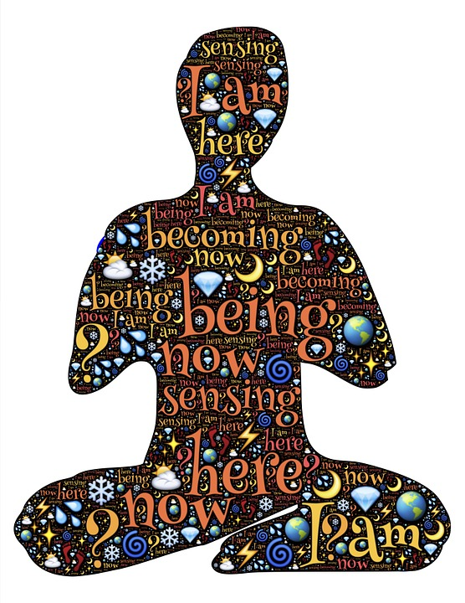
Mindfulness Workshop

Slide 2
Best practice for online delivery
During the session if you are comfortable to:
DO say hello and introduce yourself when you have been admitted into the session
DO put your camera on – it is good practice to have the camera on, so you can be seen and interact, and it helps to keep your focus.
DO mute your microphone when you are not talking. To help keep background noise to a minimum, make sure you mute your microphone when you are not speaking.
DO remember to speak to the camera and not to the screen when you are talking.
DO keep focused.
DO be courteous to other attendees. If you want to ask a question, please do not interrupt the speaker, instead, raise your hand.
Do limit distractions. You can make it easier to focus on the meeting by turning off notifications, closing or minimising running apps, muting your smartphone and not eating.

Slide 3
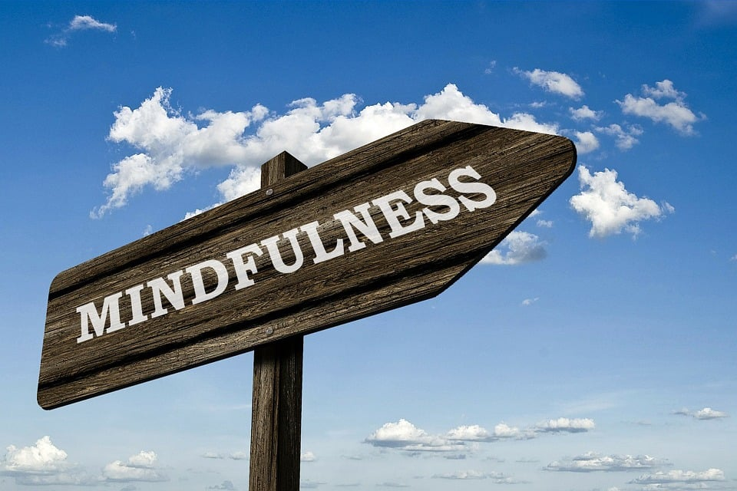
What is mindfulness?
MIND (www.mind.org.uk)
Mindfulness is a technique you can learn which involves noticing what is happening around you in the “present moment”.
It is to be aware without judgement.
Mindfulness techniques have roots in Buddhism and meditation.
Does not require you to be spiritual or have any particular beliefs.
It is a skill that requires work like any therapy and also needs practice as you would if you were learning a new skill.
Notes:
Mindfulness
It can be easy to rush through life without stopping to notice much.
Paying more attention to the present moment – to your own thoughts and feelings, and to the world around you – can improve your mental wellbeing.
Some people call this awareness "mindfulness". Mindfulness can help us enjoy life more and understand ourselves better. You can take steps to develop it in your own life.
What is mindfulness?
Mindfulness involves paying attention to what is going on inside and outside ourselves, moment by moment.
It's easy to stop noticing the world around us. It's also easy to lose touch with the way our bodies are feeling and to end up living "in our heads" – caught up in our thoughts without stopping to notice how those thoughts are driving our emotions and behaviour.
An important part of mindfulness is reconnecting with our bodies and the sensations they experience. This means paying attention to the sights, sounds, smells and tastes of the present moment. That might be something as simple as the feel of a banister as we walk upstairs.
Another important part of mindfulness is an awareness of our thoughts and feelings as they happen moment to moment.
How mindfulness helps mental wellbeing
Becoming more aware of the present moment can help us enjoy the world around us more and understand ourselves better.
When we become more aware of the present moment, we begin to experience afresh things that we have been taking for granted.
Mindfulness also allows us to become more aware of the stream of thoughts and feelings that we experience, and to see how we can become entangled in that stream in ways that are not helpful.
This lets us stand back from our thoughts and start to see their patterns. Gradually, we can train ourselves to notice when our thoughts are taking over and realise that thoughts are simply "mental events" that do not have to control us.
Mindfulness can help us deal with issues more productively. We can ask: "Is trying to solve this by brooding about it helpful, or am I just getting caught up in my thoughts?"
Awareness of this kind may also help us notice signs of stress or anxiety earlier and deal with them better.
Mindfulness-based therapies are recommended by the National Institute for Health and Care Excellence (NICE) as a way to treat less severe depression.
NICE also recommends that employers make mindfulness available to all employees, to support mental wellbeing at work.

Slide 4
How can we practice mindfulness?
Being more aware of the present moment enables you to
Become more self aware.
Feel less stressed and feel calmer.
Helps to enable you to choose how you respond to your thoughts and feelings.
Assists you to be able to cope with any difficult or unhelpful thoughts that you are feeling.
Enables you to be kinder to yourself.
Notes:
How to be more mindful
Reminding yourself to take notice of your thoughts, feelings, body sensations and the world around you is the first step to mindfulness.
Notice the everyday
As we go about our daily lives, we can notice the sensations of things, the food we eat, the air moving past the body as we walk.
Keep it regular
It can be helpful to pick a regular time, such as a morning journey to work or a walk at lunchtime, during which you decide to be aware of the sensations created by the world around you.
Try something new
Trying new things, such as sitting in a different seat in meetings or going somewhere new for lunch, can also help you notice the world in a new way.
Watch your thoughts
Some people find it very difficult to practise mindfulness. As soon as they stop what they're doing, lots of thoughts and worries crowd in.
It might be useful to remember that mindfulness isn't about making these thoughts go away, but rather about seeing them as mental events that come and go. This can be very hard at first, but with gentle persistence it is possible.
Some people find that it is easier to cope with an over-busy mind if they are doing gentle yoga or walking.
Name thoughts and feelings
To develop an awareness of thoughts and feelings, some people find it helpful to silently name them: "Here's the thought that I might fail that exam" or: "This is anxiety".
Free yourself from the past and future
You can practise mindfulness anywhere, but it can be especially helpful to take a mindful approach if you realise that, for several minutes, you have been trapped in reliving past problems or pre-living future worries.
Different mindfulness practices
As well as practising mindfulness in daily life, it can be helpful to set aside time for a more formal mindfulness practice.
Mindfulness meditation involves sitting silently and paying attention to thoughts, sounds, the sensations of breathing or parts of the body, bringing your attention back whenever the mind starts to wander.
Yoga and tai-chi can also help with developing awareness of your breathing.

Slide 6
Will it work for me?
As with everything in our lives we are all individual.
We all experience the world differently.
There is nothing to lose from trying it.
It may:
Help you to notice how thoughts come and go in your mind.
Help you to create space between you and your thoughts.
Help you notice what your body is telling you.
Reach out to your skills and development coach for support if you feel your mental wellbeing / mental health is becoming compromised.

Slide 7
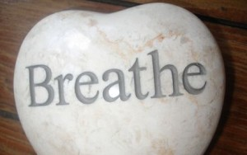
Take a moment
Let us all take a few moments to have a try at the breathing exercises.
Follow my instructions
Make sure you breathe in deeply through your nose and slowly out through your mouth

Slide 9
https://www.mind.org.uk
https://www.nhs.uk
https://www.mindful.org
https://www.headspace.com
https://www.mentalhealth.org.uk
https://www.better.org.uk
Mindfulness Apps
Headspace
Calm
The mindfulness app
Mindfulness & sleep meditation
Insight timer

