Slide 1
Managerial Interactions Workshop

Slide 2
The importance of a positive manager – employee relationship
How this impacts individual and organisational success.
In the chat bar type in some ideas as to why you think this is important.
Notes:
Fostering Individual Growth: A positive manager-employee relationship is crucial for individual growth and development. Managers who provide support, guidance, and opportunities for learning can empower employees to reach their full potential. This leads to increased job satisfaction, motivation, and a sense of accomplishment.
Boosting Organizational Performance: Positive relationships between managers and employees contribute significantly to organizational success. When employees feel valued and supported, they are more likely to be engaged, productive, and committed to their work. This translates into improved teamwork, innovation, and overall organizational performance.
Building a Strong Company Culture: A positive manager-employee relationship is the foundation of a strong and healthy company culture. When managers treat their employees with respect, fairness, and empathy, it creates a positive work environment where employees feel comfortable sharing ideas, collaborating, and taking risks. This fosters a sense of belonging, loyalty, and commitment to the organization.
Managers who prioritize their employees' growth and development create a positive impact on individual performance, job satisfaction, and retention rates.

Slide 3
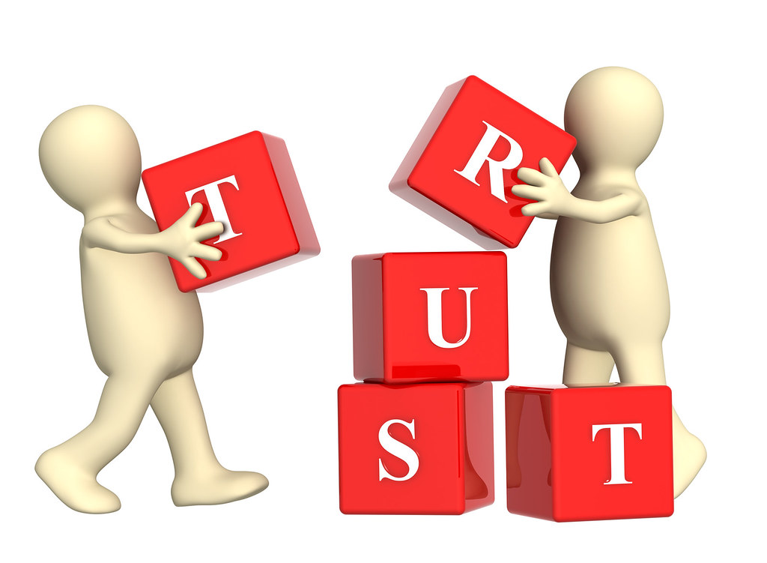
The importance of positive manager / employee relationships
Notes:
Manager-employee relationships are crucial for workplace success for several reasons. First and foremost, these relationships directly impact employee morale and job satisfaction. When employees feel valued, respected, and supported by their managers, they are more likely to be motivated, engaged, and productive in their roles. This positive relationship fosters a sense of loyalty and commitment to the organization.
Effective manager-employee relationships also facilitate open communication and collaboration. When there is trust between managers and employees, team members are more likely to feel comfortable sharing ideas, concerns, and feedback. This open dialogue enables problem-solving, innovation, and continuous improvement within the workplace.
Additionally, strong manager-employee relationships contribute to employee development and growth. Managers who take an interest in their employees' professional development, provide constructive feedback, and offer opportunities for learning and advancement help employees reach their full potential. This not only benefits the individual employees but also enhances the overall skillset and performance of the team.
Overall, cultivating positive manager-employee relationships creates a supportive and conducive work environment where employees feel empowered, motivated, and valued, leading to increased productivity, higher job satisfaction, and ultimately, organizational success.

Slide 4
This Photo by Unknown Author is licensed under CC BY-SA-NC
Notes:
10 types of managers
A team's productivity often relies on how well their manager leads them in undertaking responsibilities. Here are 10 types of managers you could encounter and what their management styles might look like:
1. Coaching managers
Coaching managers enjoy taking on a teacher-like role and typically have a good understanding of the different stages of professional development. They love to push their employees to improve by building strong personal relationships. Common qualities of a coaching manager include: Educating every employee
Considering the long-term professional development of their employees
Bringing the team together while also catering to each individual's progress
2. Authoritative managers
Authoritative managers take most of the decision-making and task delegation into their own hands while maintaining a strict protocol around their office. They often focus on adhering to rules and making sure that employees complete tasks to the company's standard of quality. Common qualities of an authoritative manager include: Prioritizing rules and operation standards
Demanding the best from their employees and holding employees accountable
Using disciplinary action when necessary
3. Results-based managers
Results-based managers primarily concentrate on whether employees meet their goals. They are more concerned that employees do their work rather than how they do it. This gives employees some power to make decisions and come up with their own methods for success. Common qualities of a results-based manager include: Being lenient in terms of protocol
Adapting to how their employees work most effectively
Focusing only on work being completed, not how it gets accomplished
4. Strategic managers
Strategic managers build their management style around the end goal they want to reach. They delegate authority to lower-level supervisors so they can focus on developing the ultimate long-term strategy for success. Common qualities of a strategic manager include: Delegating responsibility but not otherwise heavily involved in day-to-day tasks
Focusing on the overall view of their projects rather than minor details
Working independently to create plans for their employees to undertake on their own
5. Proactive managers
Proactive managers are always ready to offer help and advice and remain positive even in times of crisis. They typically focus on what actions they can take to overcome or solve any challenges that might arise and try to meet those challenges with a hands-on approach. Common qualities of a proactive manager include: Being enthusiastic about meeting goals through collaboration
Having confidence in the abilities of their employees
Being supportive of employees and poised to help
6. Laissez-faire managers
Laissez-faire managers ensure that they meet their goals, but they typically do not offer much help or supervision during work operations. They place most of the day-to-day and long-term responsibilities on their employees. You might work well under a laissez-faire manager if you prefer to work autonomously. Common qualities of a laissez-faire manager include: Remaining hands-off with daily performance
Delegating responsibility and stepping back
Giving employees autonomy to make decisions and complete tasks on their own
7. Democratic managers
Democratic managers listen to employee input and welcome employees to be a part of the decision-making process. They try to make every member of a team crucial to a project's completion. An office led by a democratic manager might feel teamwork-focused. Common qualities of a democratic manager include: Being open to suggestions and criticism
Being understanding of employees' points of view
Emphasizing collaboration among employees and the team as a whole
8. Visionary managers
Visionary managers rely on strategy to make a plan for their team, and they ultimately allow their employees to work autonomously. However, they do check in with employees regularly to ensure productivity is in line with their vision. Common qualities of a visionary manager include: Staying fair but being serious about achieving desired results
Offering large quantities of feedback
Trusting employees as long as they adhere to the established strategy
9. Transformational managers
Transformational managers are enthusiastic about growth and adapting to changes in their industry. They motivate employees to go beyond their comfort zones and constantly improve. Common qualities of a transformational manager include: Being innovative in terms of approaches to new tasks and methods of operation
Motivating and challenging employees to adapt to changes
Being heavily involved in work processes and highly supportive of employees
10. Charismatic managers
Charismatic managers prioritize building strong personal relationships with their employees and try to cater to their employees' needs whenever they can. Common qualities of a charismatic manager include: Being friendly and charming when collaborating with employees and supervisors
Being kind to employees rather than authoritative
Providing constant support and help when necessary

Slide 5
How does knowing my managers management style empower me to communicate better with them?
Notes:
Knowing your manager's communication style can empower you in several ways:
Tailoring Your Approach: Understanding your manager's preferred communication style allows you to tailor your messages to resonate with them better. For instance, if your manager prefers concise, bullet-pointed emails, you can adjust your communication to be more direct and to the point.
Building Rapport: By aligning your communication style with your manager's preferences, you can build rapport more effectively. People tend to feel more comfortable and connected with others who communicate in a similar manner to themselves.
Anticipating Responses: Knowing your manager's communication style can help you anticipate how they might respond to certain messages or situations. This foresight allows you to prepare adequately and address any potential concerns proactively.
Reducing Misunderstandings: Effective communication hinges on mutual understanding. By adapting your communication style to match your manager's preferences, you can reduce the likelihood of misunderstandings or misinterpretations, fostering clearer communication.
Enhancing Productivity: Clear and effective communication is essential for productivity in the workplace. When you communicate in a way that resonates with your manager, you're more likely to convey your ideas efficiently, leading to smoother workflows and improved outcomes.
Earning Trust: When you demonstrate an understanding of your manager's communication style, it shows that you are attentive and considerate of their preferences. This can contribute to building trust and credibility, which are crucial components of a successful working relationship.
Overall, being aware of your manager's communication style equips you with valuable insights that can help you navigate workplace interactions more effectively, ultimately contributing to your professional growth and success.

Slide 7
Useful Links
Indeed
https://www.indeed.com/career-advice/career-development/how-to-talk-to-your-boss
https://www.indeed.com/career-advice/career-development/how-to-write-email-to-your-boss
Forbes
https://www.forbes.com/sites/jacquelynsmith/2013/10/16/14-tips-for-improving-your-relationship-with-your-boss/?sh=3ae29a3d59b0

