Slide 1
Deep Dive Information Session Senior Healthcare Support Worker Level 3 - Maternity Support

Slide 2
Who are Dynamic Training?
Established in 2007
Offices in Uxbridge and Hartlepool
Delivering:
Apprenticeships
Adult Education
Bespoke Training Solutions
Supporting circa 500 learners on a variety of programmes at any one time
Over 80 NHS Trust choose Dynamic Training with their ongoing Learning & Development Needs
Matrix Accredited
Skills for Health Quality Mark
A disability confident employer
Retained our Ofsted “good” inspection grade in Sept 2021
Part of Calder Holding BV
13 companies with 1000+ employees in the UK and the Netherlands.

Slide 3
Senior Healthcare Support Worker: Maternity
This apprenticeship is perfect for:
^{Maternity Support Worker}
^{The apprentices will achieve:}
Senior Healthcare Support Worker Standard Level 3 Certificate
Level 3 Diploma in Healthcare Support
Level 2 Functional Skills in maths and English (if applicable)

Slide 4
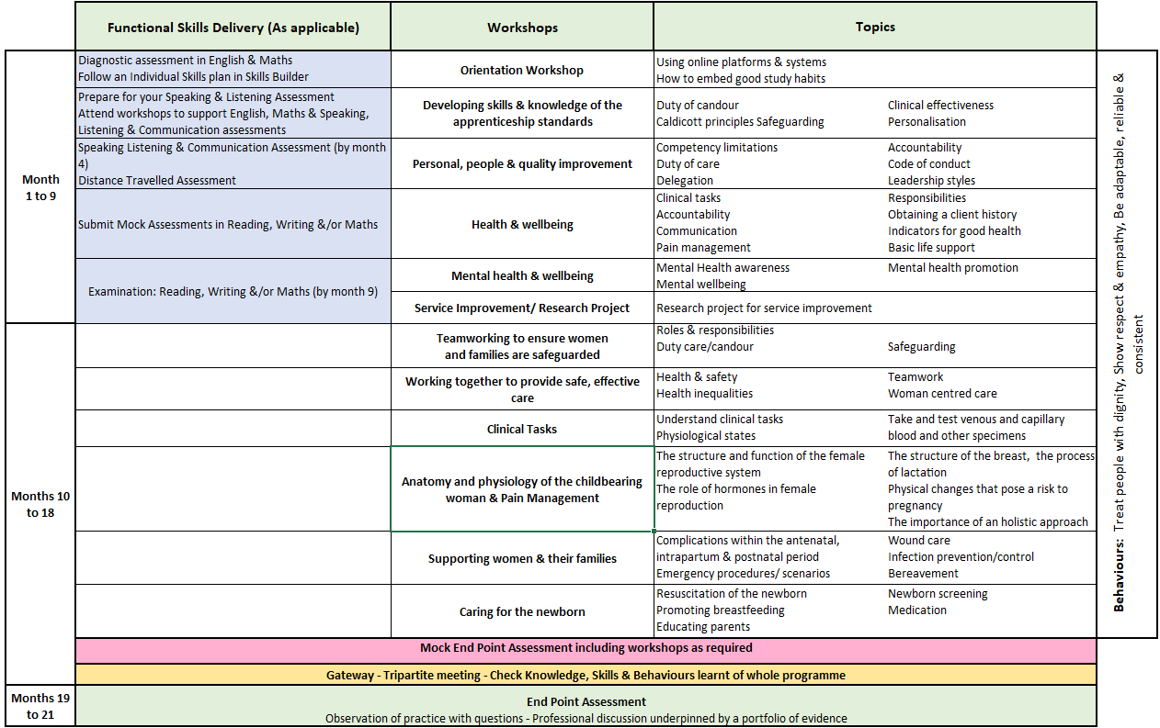
Senior Healthcare Support Worker - Maternity

Slide 5
Core & Specialist Teaching Sessions
Core
Session 1 - Introduction and study skills
Session 2 - Developing skills and knowledge of the apprenticeship standards
Session 3 - Personal, people and quality improvement
Session 4 - Health and wellbeing
Session 5 - Mental health and wellbeing
Session 6 - Service Improvement/ Research Project
Specialist
Session 7 - Team work to ensure women and families are safeguarded
Session 8 - Working together to provide safe, effective care
Session 9 - Clinical Tasks
Session 10 - Anatomy and physiology of the childbearing woman & Pain Management
Session 11 - Supporting women and their families
Session 12 - Caring for the newborn

Slide 6
Core & Specialist Diploma Units
Mandatory
Promote personal development in care settings
Safeguarding and protection in care settings
Promote health, safety and wellbeing in care settings
Maintaining Quality standards in the Health Sector
Person-centred Practice, Choice and independence
Effective communication in care settings
Responsibilities of a Senior Healthcare Support Worker
Promote effective handling of information in care settings
Service Improvement within the Health Sector
Communicate with individuals about promoting their Health and Wellbeing
Duty of care in care settings
Promote equality and inclusion in care settings
Study Skills for Senior Healthcare Support Workers
Contribute to Monitoring the Health of Individuals Affected by Health Conditions
Undertake Physiological Measurements
Provide Support to Manage Pain and Discomfort
Optional Units (specialist) - Examples
Provide Advice and Information to Enable Parents to Promote the Health and Wellbeing of Their Newborn Babies
Obtain Venous Blood Samples
Care for a Newborn Baby
Anatomy and Physiology for Maternity Support Workers
Obtain and Test Capillary Blood Samples
Support Individuals with Feeding Babies
Notes:
65 credits total
45 credits in mandatory
Specialist (min 20 credits) below is 21 163 units!!!

Slide 7
End Point Assessment
End Point Assessment (EPA) happens at the end of the programme
Apprentices need to pass this to achieve their apprenticeship
EPA involves independent assessment at the end of the programme which includes:
Observation in practice with questions
Professional discussion underpinned by the learner portfolio
From this apprentices can achieve: Fail, Pass or Distinction
Notes:
Also discuss mock assessment methodology and activity

Slide 8
The Apprentice Journey
Notes:
Pre programme start
Information Advice and Guidance– informed decision – right learner, right time, right programme.
Application to check eligibility and identify prior experience and learning must be completed
Skillscan to identify prior learning and experience against the standard
Potential apprentices complete the Skills Builder online assessments prior to confirmation to ensure learner is at right level of English and maths. Signposting to support to upskill offered.
Cognassist neurodiversity assessment: helps learners identify their learning style and supports with strategies which are built into their portfolio with the support of their skills coaches.
Meeting with manager, coach and apprentice to confirm and agree learning plan.
Programme Start
Induction - official start to programme
Online workshops once/twice a month for duration of programme
via Zoom, fully interactive.
Coach support – remotely via an eportfolio monthly booked session plus ongoing communication
Assessment in the workplace - observations or witness statements every 12 weeks
Review every 12 weeks (manager/mentor, learner, skills and development coach)
Additional Functional & Digital Skills embedded into our taught sessions as well as providing additional support through Skills Builder and online sessions

Slide 9
Dedicated Learning Time
Activity | Average Duration
Teaching and Learning Reviews | 2 hours– in person or online The Apprentice will meet their Coach every 4-6 weeks Line manager/workplace mentor is expected to be present to support the Apprentice as part of this.
10 to 12-Week Progress Reviews | 90 mins every 10 to 12 weeks This is a three-way discussion involving the Coach, Line Manager/Workplace Mentor, and Apprentice - share understanding of progress against the full apprenticeship
Online Workshops via MS Teams / Zoom | Approximately once per month, subject to programme Full day workshops to teach the knowledge and skills against the required standard Workshop dates are planned in advance for whole programme.
Independent learning / time for study: In work learning | Minimum half a day per week required as protected study time – written into the off duty. 1-2 hours per week
Notes:
Independent learning / time for study – reading, watching developmental videos, research tasks and projects
In work learning – Shadowing, stepping up, coaching, mentoring

Slide 10
Impact of Learning: Theory to Practice Understanding
We want and expect all apprentices apply what they have learned during their apprenticeship to their job role. When we observe apprentices in the workplace or complete an assessment on a witness statement, we would expect to see a multitude of good practice in the workplace including:
Correct application of national and local legislation, guidance, polices and SOPS’s
Person centred care given to each individual patient
The importance of pre and post procedural checklists
Gaining consent
Risk assessment completed for infection control, health & safety, wearing of PPE and manual handling tasks
Understanding of the positioning of patients for various imaging procedures
Understanding of their role in quality assurance checks.
Accurate recording and escalation process
Understand medical emergencies in the clinical environment
What is good role modelling, leadership, mentoring and teamwork
Excellent multiprofessional communication skills
Understanding barriers to communication when caring for patients
Consent, mental capacity and the use of advocates in patient care episodes
Greater understand of anatomy, physiology and human structure.
Confidence and competence in cannulation
Notes:
Contextualising theory to role

Slide 11
Examples of Service Improvement Projects
Colour coded labelling of stock room
Project on quality assurance of equipment cleanliness
Patient satisfaction survey
Roles & responsibilities in maternity wards explained simply leaflet
Sharing best practice across hospitals (with other apprentices) project
Mentoring colleagues / CPD workbook
Standardising new starters

Slide 12
E-learning Tools and Portals
The tools learners use to support achievement of their apprenticeship programme

Slide 13
Learner Journal
Employers will have access to view learners OneFile.
Learner Journal reflections are a good way of seeing what is happening at floor level and identifying any changes that need to be implemented.
These reflections can often form the basis for team learning days and CPD.
We are offering a monthly repeated training session for Line managers, mentors or apprenticeship / Educators on how to get the most out of OneFile.

Slide 14
Methods of Assessment
After each teaching session a Learning Assessment Record (LAR) will be released on OneFile with learner instructions and resources.
Coaching will be given to learners that require support.
Assessment methods include.
Workbooks
Expert Witness Testimony's
Competency Based Assessments
Professional Discussion
Recorded Prior Learning
Observations in the workplace

Slide 15
Mentoring an Apprentice Workshops
Aimed at the learner’s line manager or mentor
Workshops are delivered monthly online – 2.5 hours
By the end of the session, you will be able to:
Describe the structure of an apprenticeship programme
Explain the principles that underpin the mentoring process
Initiate and establish a mentoring process with an apprentice

Slide 16
Any questions ?
hello@dynamictraining.org.uk
Thank you.

