Slide 1
Information Session Senior Healthcare Support Worker Level 3 - Allied Health Professional

Slide 2
Who are Dynamic Training?
Established in 2007
Offices in Uxbridge and Hartlepool
Delivering:
Apprenticeships
Adult Education
Bespoke Training Solutions
Supporting circa 500 learners on a variety of programmes at any one time
Over 80 NHS Trust choose Dynamic Training with their ongoing Learning & Development Needs
Matrix Accredited
Skills for Health Quality Mark
A disability confident employer
Retained our Ofsted “good” inspection grade in Sept 2021
Part of Calder Holding BV
13 companies with 1000+ employees in the UK and the Netherlands.

Slide 3
Senior Healthcare Support Worker: Theatre Support
This apprenticeship is perfect for:
^{Theatre Support Workers}
^{The apprentices will achieve:}
Senior Healthcare Support Worker Standard Level 3 Certificate
Leve 3 Diploma in Healthcare Support
Level 2 Functional Skills in maths and English (if applicable)

Slide 6
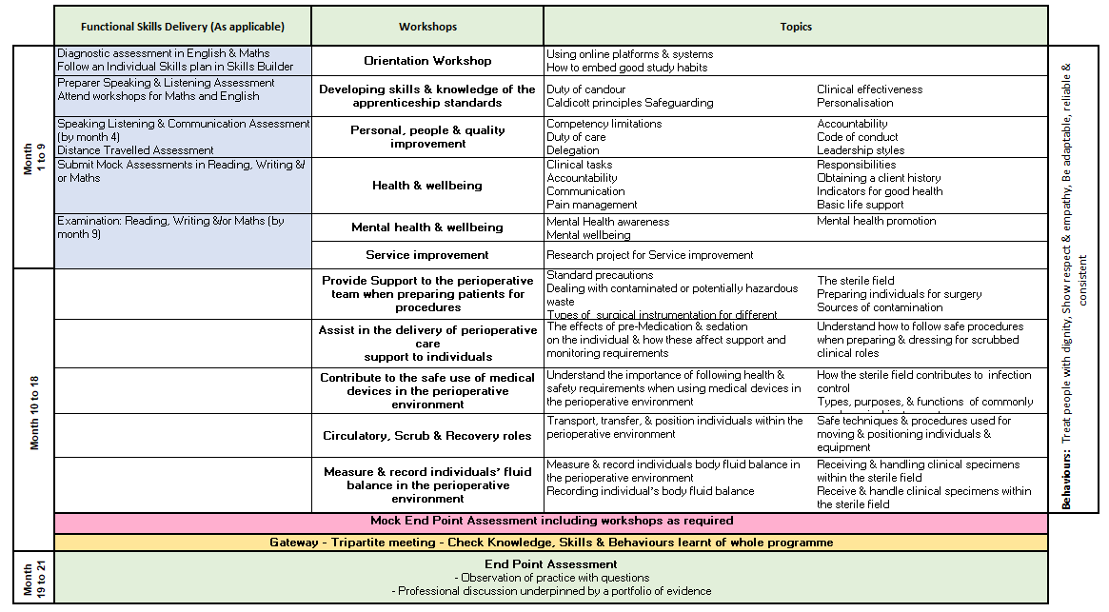
Senior Healthcare Support Worker: Theatre Support

Slide 7
End Point Assessment
End Point Assessment (EPA) happens at the end of the programme
Apprentices need to pass this to achieve their apprenticeship
EPA involves independent assessment at the end of the programme which includes:
Observation in practice with questions
Professional discussion underpinned by the learner portfolio
From this apprentices can achieve: Fail, Pass or Distinction
Notes:
Als discuss mock assessment methodology and activity

Slide 8
Theory to Practice Understanding
It is an expectation that all apprentices apply what they have learned during their apprenticeship to their job role. When we observe apprentices in the workplace or complete an assessment on a witness statement, we would expect to see the following examples of good practice
Correct application of national and local legislation, guidance, polices and SOPS’s
Participation in the WHO Safer Surgery Checklist
Person centred care given to each induvial patient
Consent gained with awake patients
Risk assessment completed for infection control, health & safety, wearing of PPE and manual handling tasks
Competence in accountable items, specimens and fluid management in the perioperative environment
Understanding of safe transport, transfer and positioning of patients in the perioperative environment
Accurate recording and escalation process
Understand medical emergencies in the perioperative environment
What is good role modelling, leadership, mentoring and teamwork
Excellent multiprofessional communication skills
Understanding barriers to communication when caring for patients
Consent, mental capacity and the use of advocates in patient care episodes
End of Life considerations, within religion, culture and patient / family wishes

Slide 9
Adapting Diploma Units to Learner Needs
Example:
A Level 3 learner was completing the Adult pathway.
They worked in outpatients and as part of their role they assisted in minor surgery.
I was able to allocate a perioperative module to accommodate this essential learning.
Service improvement :
The coach and learner will work with the employer to identify a service improvement that would benefit the whole department.
This can be used as the basis of the service and quality improvement project completed in the first 4 months of the apprenticeship.

Slide 10
Core & Specialist Teaching Sessions
Core
Session 1 - Introduction and study skills
Session 2 - Stretch and challenge
Session 3 - Personal, people and quality improvement
Session 4 - Health and wellbeing
Session 5 – Mental health and wellbeing
Session 6 – Service Improvement Project
Specialist
Session 7 - Perform the non-scrubbed / scrubbed circulating role
Session 8 - Assist in the delivery of perioperative care and support to individuals
Session 9 – Prepare, check and use medical devices safely in the perioperative environment
Session 10 - Transport, transfer and position individuals - perioperative environment
Session 11 - Measure & record individuals body fluid balance - perioperative environment

Slide 11
Example of Teaching Session Slides

Slide 12
Examples of Service Improvement Projects
Specimen Board
Adult Care
WHO Checklist – not a tick box exercise
Theatres
Understanding Accountable Items
Theatres
Renal Dialysis explained simply leaflet
Adult Care
Blood Bottles - order of draw
Recovery
Identifying and labelling specimen in the scrub role.
Theatres

Slide 13
Learner Journal
Employer will have access to view learners OneFile.
Learner Journal reflections are a good way of seeing what is happening at floor level and identifying any changes that need to be implemented.
These reflections can often form the basis for team learning days and CPD.
We are offering a monthly repeated training session for Line managers, mentors or apprenticeship / Educators on how to get the most out of OneFile.

Slide 14
Methods of Assessment
After each teaching session a learning assessment record (LAR) will be released on OneFile with learner instructions and resources.
Coaching will be given to learners that require support.
Assessment methods include.
Workbooks
Expert Witness Testimony's
Competency Based Assessments
Professional Discussion
Recorded Prior Learning

Slide 15
The Apprentice Journey
Notes:
Pre programme start
Information Advice and Guidance– informed decision – right learner, right time, right programme.
Application to check eligibility and identify prior experience and learning must be completed
Skillscan to identify prior learning and experience against the standard
Potential apprentices complete the Skills Builder online assessments prior to confirmation to ensure learner is at right level of English and maths. Signposting to support to upskill offered.
Cognassist neurodiversity assessment: helps learners identify their learning style and supports with strategies which are built into their portfolio with the support of their skills coaches.
Meeting with manager, coach and apprentice to confirm and agree learning plan.
Programme Start
Induction - official start to programme
Online workshops once/twice a month for duration of programme
via Zoom, fully interactive.
Coach support – remotely via an eportfolio monthly booked session plus ongoing communication
Assessment in the workplace - observations or witness statements every 12 weeks
Review every 12 weeks (manager/mentor, learner, skills and development coach)
Additional Functional & Digital Skills embedded into our taught sessions as well as providing additional support through Skills Builder and online sessions

Slide 16
E-learning Tools and Portals
The tools learners use to support achievement of their apprenticeship programme

Slide 17
Dedicated Learning Time
Activityaa | Average Duration
Teaching and Learning Reviews | 2 hours– in person or online The Apprentice will meet their Coach every 4-6 weeks Line manager/workplace mentor is expected to be present to support the Apprentice as part of this.
10 to 12-Week Progress Reviews | 90 mins every 10 to 12 weeks This is a three-way discussion involving the Coach, Line Manager/Workplace Mentor, and Apprentice - share understanding of progress against the full apprenticeship
Online Workshops via MS Teams / Zoom | Approximately once per month, subject to programme Full day workshops to teach the knowledge and skills against the required standard Workshop dates are planned in advance for whole programme.
Independent learning / time for study: In work learning | Minimum 6.5 hrs per week required as protected study time – written into the off duty. 1-2 hours per week
Notes:
Independent learning / time for study – reading, watching developmental videos, research tasks and projects
In work learning – Shadowing, stepping up, coaching, mentoring

Slide 18
Mentoring an Apprentice Workshops
Aimed at the learner’s line manager or mentor
Workshops are delivered monthly online – two hours
By the end of the session, you will be able to:
Describe the structure of an apprenticeship programme
Explain the principles that underpin the mentoring process
Initiate and establish a mentoring process with an apprentice

Slide 19
Any questions ?
hello@dynamictraining.org.uk
Thank you.

