Slide 1
Information Session Peer Worker Skills Bootcamp

Slide 2
Who are Dynamic Training?
Established in 2007
Offices in Uxbridge and Hartlepool
Delivering:
Apprenticeships
Bootcamps
Bespoke Training Solutions
Supporting circa 500 learners on a variety of programmes at any one time
Over 80 NHS Trust choose Dynamic Training with their ongoing Learning & Development Needs
Matrix Accredited
Skills for Health Quality Mark
A disability confident employer
Retained our Ofsted “good” inspection grade in Sept 2021
Part of Calder Holding BV
13 companies with 1000+ employees in the UK and the Netherlands.

Slide 3
What Is the Peer Worker Skills Bootcamp?
Target Audience:
Unemployed (including volunteers) individuals with mental health lived experience
Aim to get into employment in a Peer Support Worker role.
Goals:
Achieve Level 3 Peer Worker Certificate
Receive coaching for career development
Develop your knowledge, skills and behaviours to transition into Peer Support Worker roles
Notes:
The Peer Support Worker (Mental Health) Skills Bootcamp is for individuals who are either employed as a peer worker/lived experience role or unemployed (but are currently or able to access volunteering opportunities) with mental health lived experience – do you have a job coach?
Who are looking to progress into Peer Support Worker job roles. Learners will achieve the accredited Level 3 Peer Worker Certificate as well as receive coaching to support and develop them in preparation for a role either volunteering or employed in peer support.

Slide 4
The Role of a Peer Support Worker
Peer Support Workers have lived experience of mental health challenges. Their approach is to support others, built on shared experiences and empathy.
Peer support workers join other members of someone’s care team to help support their wellbeing and provide inspiration for their recovery
Peer Support Workers:
Inspire hope that people can and do recover;
Walk with people on their recovery journeys;
Dispel myths about what it means to have a mental health condition or substance use disorder;
Provide self-help education and link people to tools and resources; and
Support people in identifying their goals, hopes, and dreams, and creating a roadmap for getting there.

Slide 5
Peer Support Worker Occupation
Found In: Various sectors:
Third Sector
Community
Social Enterprise
Statutory (NHS, health, justice, housing)
Private Providers of Specialist Services
Historical Significance:
Rooted in social justice, human rights, and community action
Unique Requirement:
Open exclusively to individuals with expertise through lived experience
Notes:
This occupation is found in a range of services that embed peer-led roles within third sector, community organisations such as charities, social enterprise and statutory sectors, including the NHS, health, justice, housing, and private providers of specialist services. Peer support has a long history in social justice, human rights and community action – 2 routes – self-help and mutual support and collective advocacy.
The occupation is unique in that it is only open to those who have expertise through lived experience.
The NHS Mental Health Implementation plan identifies opportunities for growth of peer support workers within the NHS with new roles across the NHS designed as part of the NHS Long Term Plan ambitions and meet the mental health needs of patients and service users. The bootcamp is in place to support the growth of demand for Peer workers who will be work ready for the roles.

Slide 6
Peer Worker Bootcamp model of delivery
Duration: 12 weeks taught – 1 workshop per week online via MS Teams - 6 hours each (09:30 to 15:30)
Delivered by: Our qualified peer worker with lived experience
Achievement: Level 3 Certificate in Peer Support Worker Theory and Practice (2 mandatory units / 14 credits)
Target Audience: Adult practitioners in peer support roles:
Volunteers in Peer Support
Unemployed looking to get employed in a Peer Worker role
Self-directed study hours completed by the learner
Wraparound coaching support between sessions
Notes:
Evidence marked. Externally set, internally marked. NEED A LAPTOP/COMPUTER/IPAD, NO PHONES
Activities and class based scenarios assessed. – Slides and handouts, reflections, discussions, role plays
Portfolio assessed.
Quality Assured - internally and externally.
Full evaluation at end and Session feedback for every session.

Slide 7
Peer Worker Bootcamp model of delivery
You will build a portfolio of evidence to record reflections, discussions, workbooks and research via our Portfolio.

Slide 8
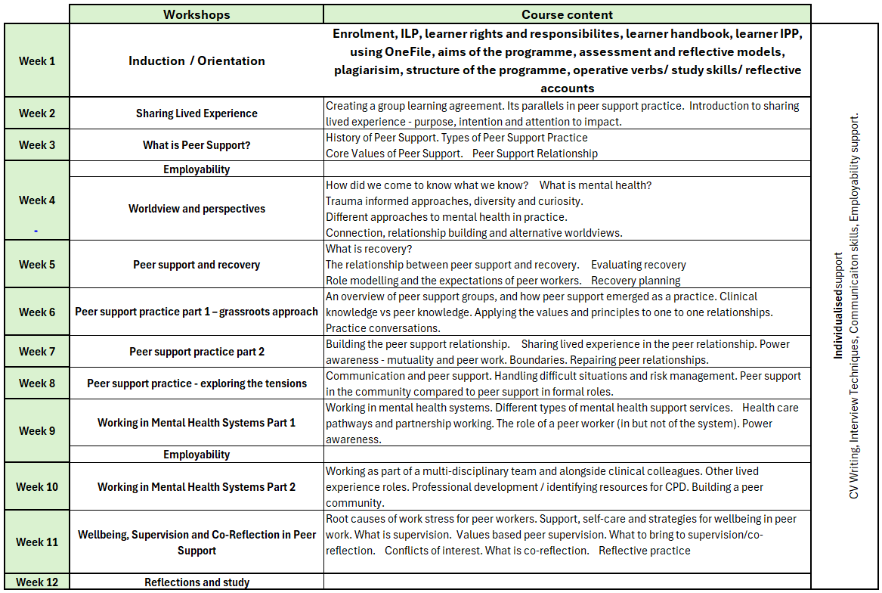
Peer Worker Bootcamp Delivery

Slide 9
Career Advancement and Skills Development
Progression: Opens doors to other qualifications and roles in health and social care sector
Mapped to: Level 3 Peer Worker Apprenticeship
Recognised as prior learning, speeds up apprenticeship completion
Outcome: Better prepared to secure employment as a Peer Support Worker

Slide 10
Programme Eligibility
To be eligible for funding for the Peer worker skills Bootcamp you must be:
Living within Greater London or the fringe areas of:
Be ready to start work as a Peer Worker after completion of the Peer Worker Skills Bootcamp
Have a good level of English to enable you to progress through the programme
Must have access to a Laptop or Computer to participate (not mobile phones)
Commitment to attend every workshops and achieve within the 12-week timeframe.
Notes:
Have Microsoft Office/Word

Slide 11
Questions For Reflection?
How would this benefit me?
Would I be able to commit?
What other commitments do I currently have?
Can I source a volunteering opportunity?
Will I be ready to start employment in the next 12 weeks?

Slide 12
Next Steps
Programme start date: 27th June 2024 Make an informed decision.
Application form and assessment completed prior to confirmation that you are on programme. All must be completed by 24th June 2024 for you to be accepted onto the programme.

Slide 13
Any questions ?
hello@dynamictraining.org.uk
Latoya.labor@dynamictraining.org.uk
Thank you

